Slide 1

Are You Drunk Sql Server?
Where did that estimate come from?

Slide 2

Session Content
Introduction to Cardinality Estimation
Methods for Cardinality Estimation
Old-school (Pre SQL Server 2014)
New-school (Up to SQL Server 2022)
Get into the head of SQL Server

Slide 3

Magnus Ahlkvist
Transmokopter SQL AB – SQL Server Specialist
Swede
MVP Data Platform, MCT
github.com/transmokopter
@Transmokopter on Twitter

Slide 4

Introduction to Cardinality Estimation

Slide 5
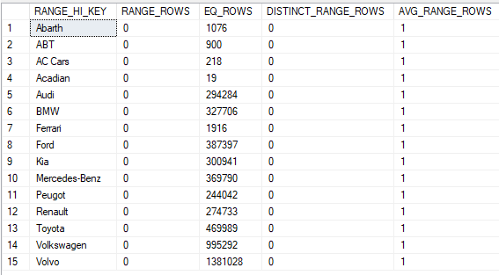
The basics, statistics and histograms
Sql Server uses statistics to figure out how many rows are returned from different operators
Statistics are stored in histograms (think of tables, they really are)
SELECT * FROM dbo.Car WHERE BrandName = ’Renault’;
Renault is in the histogram. SQL Server will estimate 274733 rows
SELECT * FROM dbo.Car WHERE BrandName = ’SAAB’;
Saab is not in the histogram. SQL Server will look at Toyota and AVG_RANGE_ROWS and estimate 1 row.

Slide 6
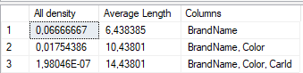
There’s more to statistics: Density
Histograms are only created on leading columns.
Imagine this index:
CREATE INDEX ix_Car_BrandName_Color ON dbo.Car (BrandName, Color) WITH (DATA_COMPRESSION=PAGE);
Two key columns. How to figure out cardinality of a combination of these two? Histogram only show BrandName, not Color.
Density Vector
Density = Distinct combinations / total number of rows

Slide 7

DEMO

Slide 8
When SQL Server knows it all, but is still wrong
Setup:
Perfectly updated statistics
SQL Query gets first all blue Volvos
Then SQL Query gets all Ferraris
First time a query is executed, the execution plan is generated based on the parameter values of that first execution
Second time a query is executed, the execution plan is reused (unless too much has changed in the underlying tables since the plan was generated)
Parameter Sniffing

Slide 9
Parameter Sniffing
Imagine a 12 table join
…that runs 10 times per minute
…and that takes a second to compile
…and SQL Server would have to compile a new plan every time the query runs
Parameter sniffing saves the parameter settings of the first execution into the plan and caches the plan.
This is generally a very good idea. Except when it’s not
There are 1,4 million Volvos in Sweden
But only 1900 Ferraris
When joining the result of a BrandName-search into the Car table into some other table, it matters if we get 1900 or 1,4 million rows back from the Car table

Slide 10

DEMO

Slide 11

DEMO

Slide 12

DEMO

